Slide 1
Low Cost Lighting System
John Nduli EN292-0396/2011 Andrew Omondi EN292-0396/2011

Slide 2
Introduction
Problem Statement
Objectives

Slide 3
Why this system
Cheap
Fully Functional
Locally made
Learning experience

Slide 4
Methodology
Functional Requirements
Nature of Motion and Circuitry
Structural Characteristics
Selection of the Most Promising Mechanism and Circuit Elements

Slide 5
Tools Used
Proteus ISIS for Curcuit Simulation and Design
Atmel Studio for Programming
Solid Works for Mechanical Design and Simulation
Latex for documentation
Microsoft PowerPoint for presentation

Slide 6
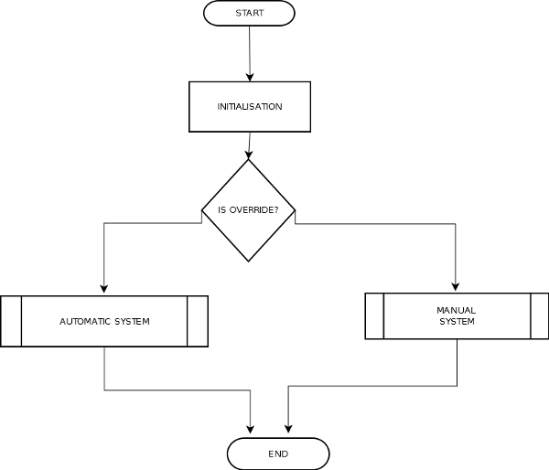
System Chart 1

Slide 7
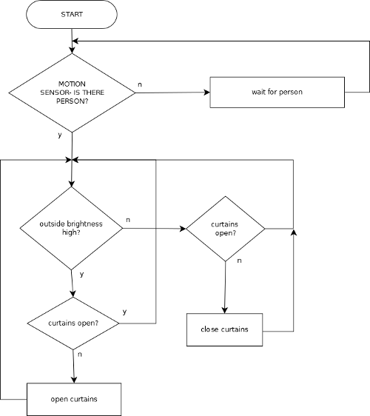
System Chart 2

Slide 8
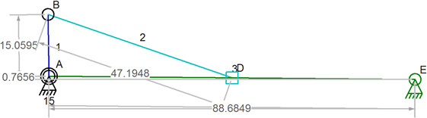
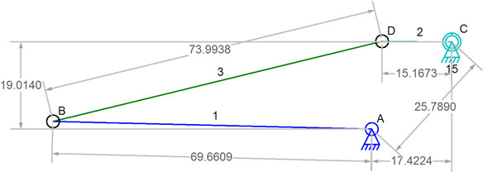
Results
Door Mechanism
Curtain Mechanism

Slide 9
Results
Lighting System
Motor Circuit
Motion Sensor

Slide 10
Demonstrations
Solid Works Designs and Simulations
Proteus Simulation
Overview of the Code

Slide 11
Learning Outcomes of the Project
Programming microcontrollers in C
Project Planning and Documentation
Structural Design and Testing in Solid Works
Circuit Simulation in Proteus
Material Sourcing
The importance of Team Work

Slide 12
Challenges
Time constraints that limited the planned production phase
Burnt uC and components
Financial constraints

Slide 13
Acknowledgements
Mr. Wamai
JKUAT

Slide 14
Conclusion
Successful demonstration of a working system that is implementable

Slide 15
Questions

Slide 16
The End
(Audience CLaPS)

